Slide 1
Scam Trainer Web App for Older Generation
Robert Bolgzds

Slide 2
Guidelines
Single focus pages
Simple layout and colors
Explicit intent
Icons paired with text
Text
At least 16px font
Sans-serif Arial, Helvetica
Contrasting color scheme to help with color blindness

Slide 3
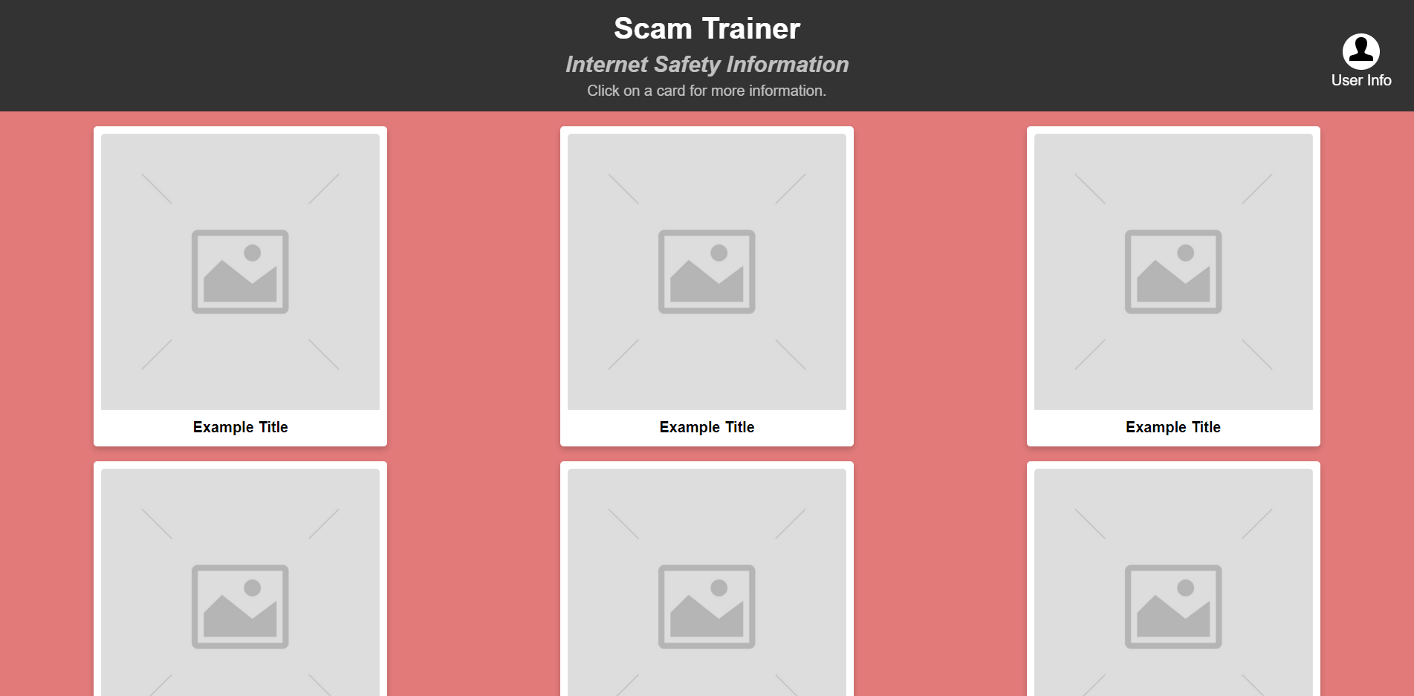
Design

Slide 4
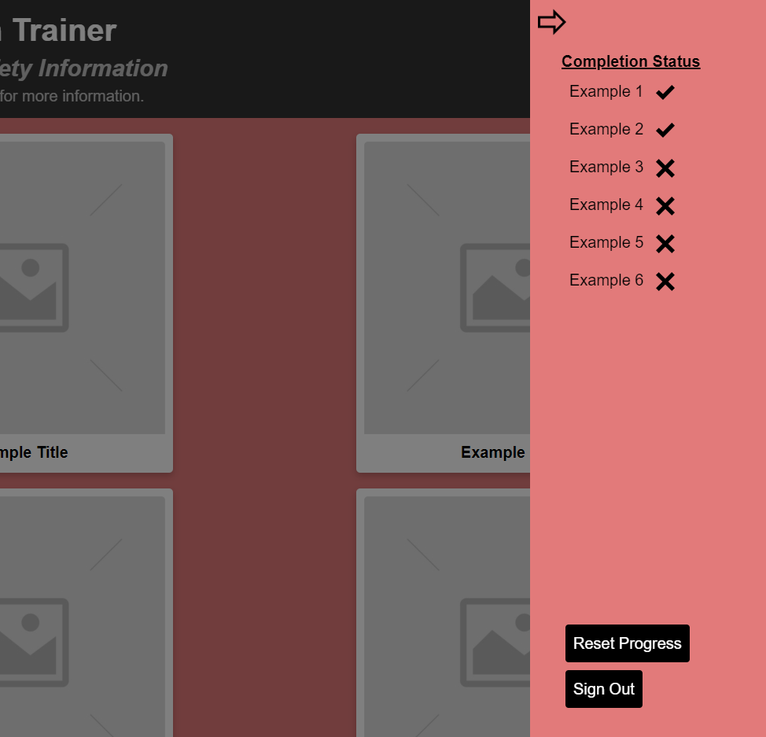
Design cont.

Slide 5
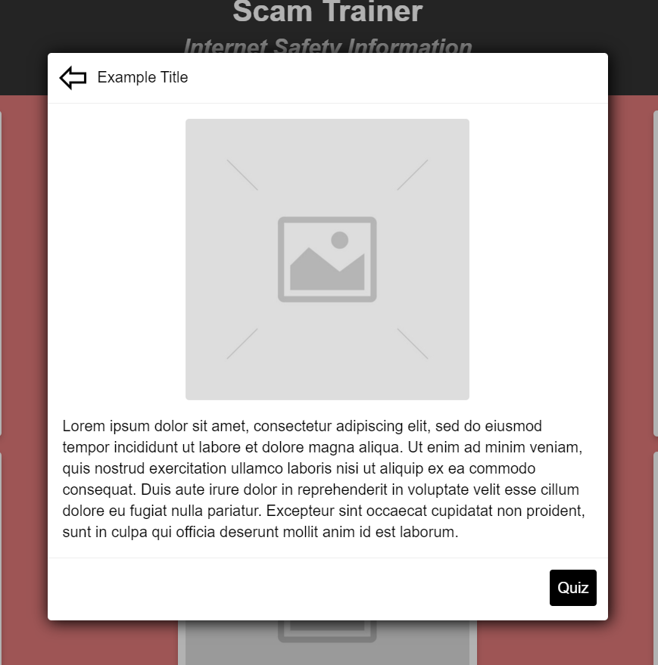
Design cont.

Slide 6
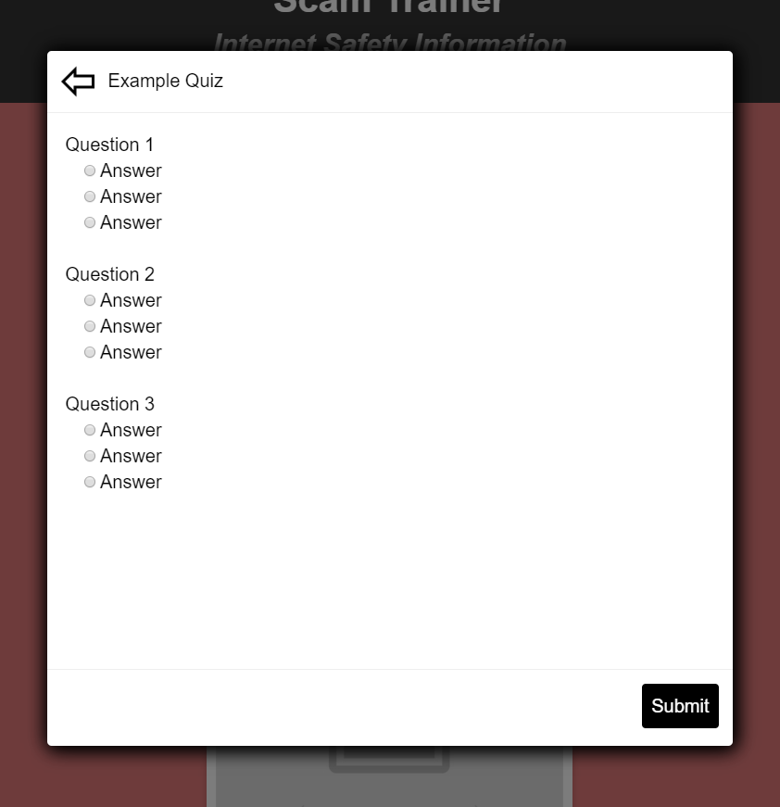
Design cont.

Slide 7
Improvements
User-centered/participatory design
Incorporate more testing
Retainability
Ease of navigation
Add tutorial on first visit
Add logging for usage statistics

